Slide 1
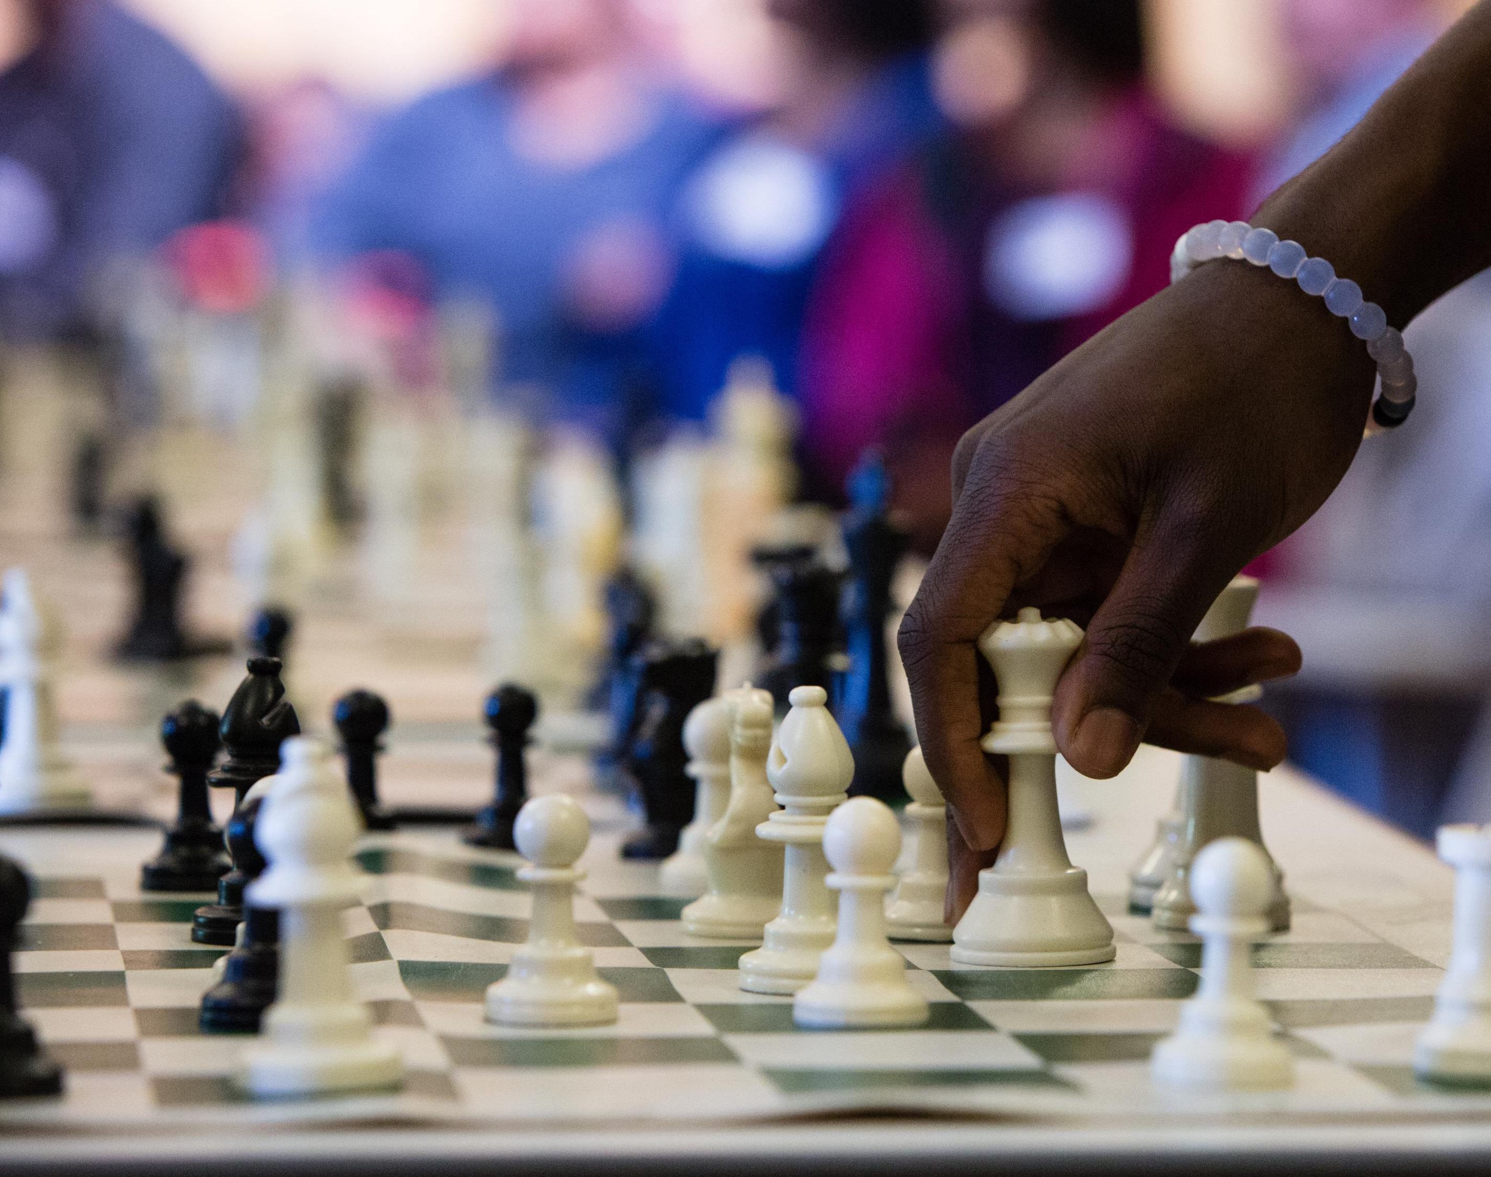
The First-move Advantage: An Analysis of 20,000 Chess Games
Michael Hotaling DSC530 Bellevue University
Sources: https://theundefeated.com/features/chess-masters-these-black-boys-aint-no-rook-ies/

Slide 2
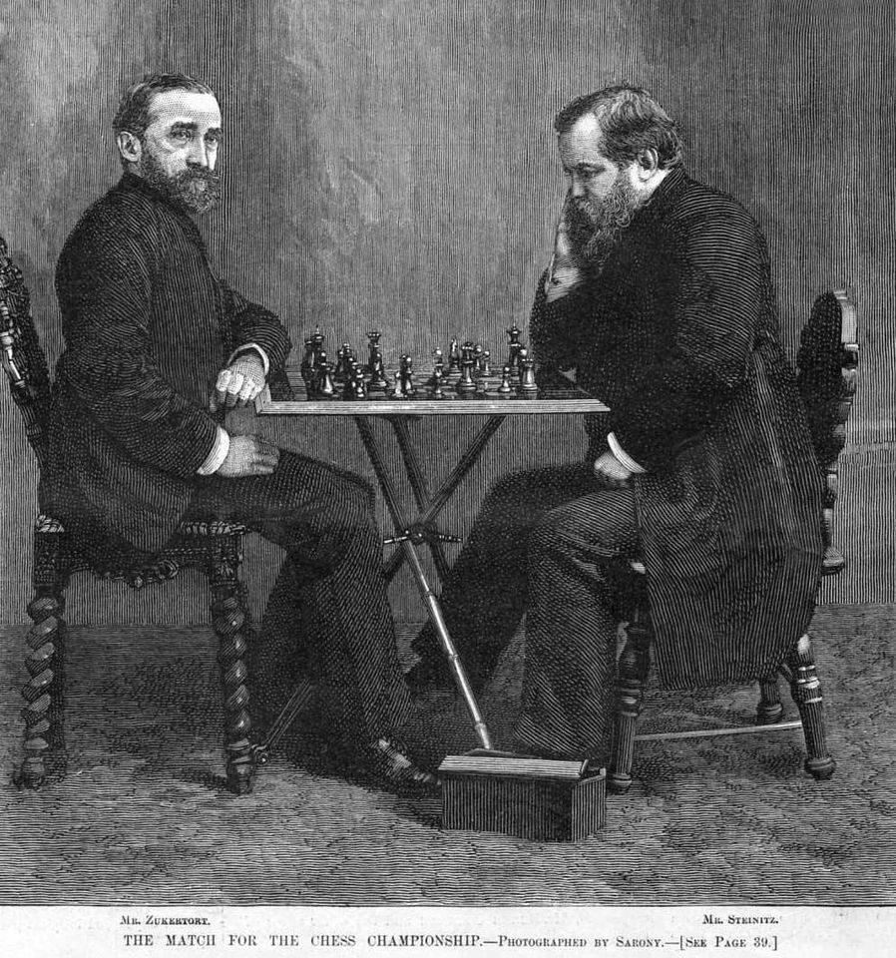
Abstract
In chess, there is a widely accepted theory that the player who moves first (typically White) has a biased advantage in the game.
This theory first gained traction amongst chess grandmasters when debating whether or not a perfect game would results in a White victory or a draw. For example, in 1889, American chess master, Wilhelm Steinitz argued that the perfect game would results in a draw. Originally, the thought of the First-move advantage being sufficient enough to influence the game was controversial, yet statistics show it’s impact is much more pronounced than first though.
In 1946, chess player W.F. Streeter analyzed 5,598 chess games from 45 chess tournaments between 1851 and 1932. Streeter found that White typically scored more than 52% total wins vs Black, leading him to the conclusion that White has an inherent advantage.
This was later verified two decades later in 1969, when Arthur M. Stevens analyzed 56,000 games and came to the same conclusion.
More recent sources indicate that White typically wins between 54% and 56% of games. Websites like Chess.com and Lichess have open source statistics on games, with Chess.com currently reporting White winning 54.95% of games. http://www.chessgames.com/chessstats.html
Source: https://www.facebook.com/pages/category/Athlete/Wilhelm-Steinitz-2059715207667147/

Slide 3
The Data
For this project, I’ll be utilizing a dataset available on Kaggle.com, Chess Game Dataset (Lichess), a dataset created by Mitchell Jolly in 2017. The dataset contains more than 20,000 online chess games which were collected from Lichess.org, a website that allows users to play and learn chess without the hassle of pieces and boards.

Slide 4
The Data
The dataset contains several attributes which will be helpful to our analysis. The attributes are as follows:
Game ID – Each game has a unique identification code. We probably only use this to verify there are no repeated games in our dataset.
Rated (T/F) – Lichess games can be rated and non-rated. Rated games give the winner of the game a higher Elo score and the loser a lower Elo score. Non-rated games don’t impact scores
Start Time – The start time of the game (Unix Timestamp)
End Time – The end time of the game (Unix Timestamp)
Number of Turns – The number of moves made in the game by both black and white. This is somewhat of a poor name since 1 turn involves moves from both players by FIDE definition.
Victory Status – How did the game end? Checkmate, Timeout, or Resignation.
Winner – The winner of the game. White, Black, or Draw
Time Increment – The time settings of the game established before the game starts. This contains two unique values. The base time (e.g. 5 minute game) and a special modifier which allows players to reclaim time with each move (+3 seconds per move)
White Player ID – Whites user name
White Player Rating – Whites Elo rating (in the current game)
Black Player ID – Blacks user name
Black Player Rating – Blacks user rating In the current game)
Moves – The moves in the game in standard PGN notation.
Opening Eco (Standardized Code for any given opening)
Opening Name - The code name for each opening, available here
Opening Ply – The number of moves in the opening phase

Slide 5
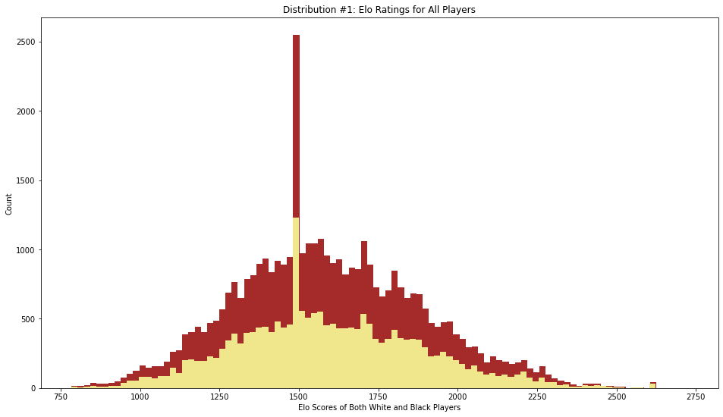

Histogram #1: Elo Ratings for All Players
Lets first examine a histogram of players scores. We can see that our scores are somewhat normally distributed with scores of 1550 being the center of the distribution. We have several players with Elo ratings at exactly 1500, which I believe is from new players making accounts and getting assigned that value when they start. We can remove a lot of these outliers by checking only rated games.

Slide 6
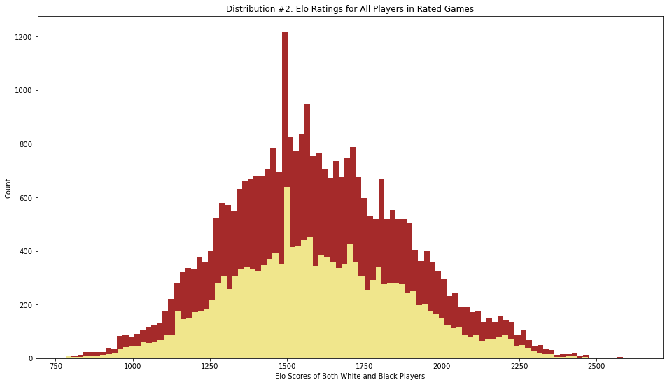

Histogram #2: Elo Ratings in Rated Games
When we exclude games that aren’t rated, we get a much more normally distributed curve with less outliers at 1500.
We can go even father and remove the players with scores of exactly 1500 since we have many outliers at this point.

Slide 7
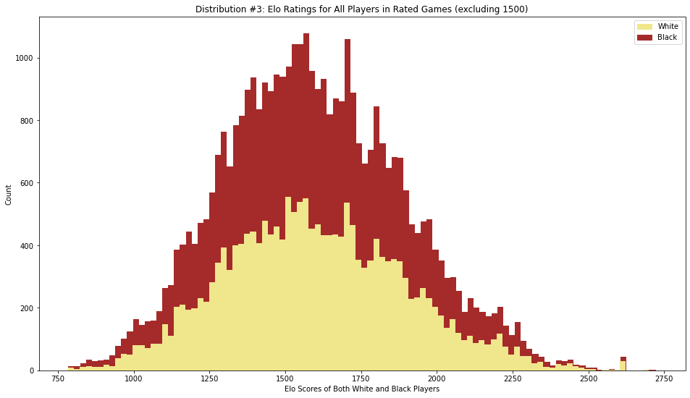

Histogram #2: Elo Ratings in Rated Games (excluding 1500)
Now after cleaning our data, we can see a nice distribution of scores. We can fit a normal distribution to this data using Python.

Slide 8
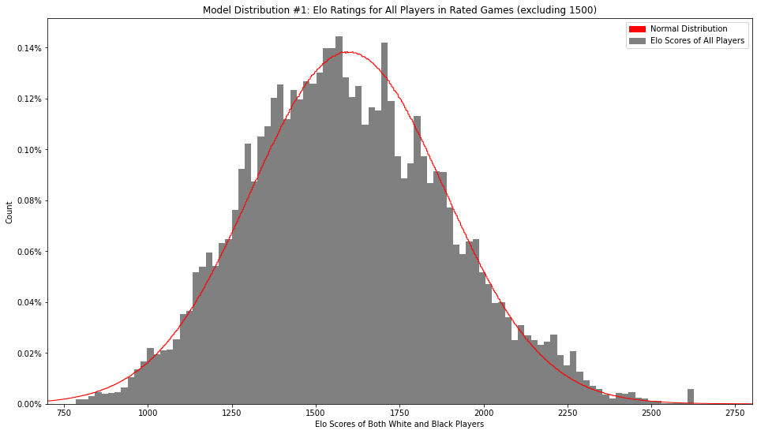

Model Distribution #1: Elo Ratings in Rated Games (excluding 1500)
Now after cleaning our data, we can see a nice distribution of scores. We can fit a normal distribution to this data using Python. There is a slight skew due to the number of high level players that play on Lichess, as we can see from the large spike near the end of our density curve.

Slide 9
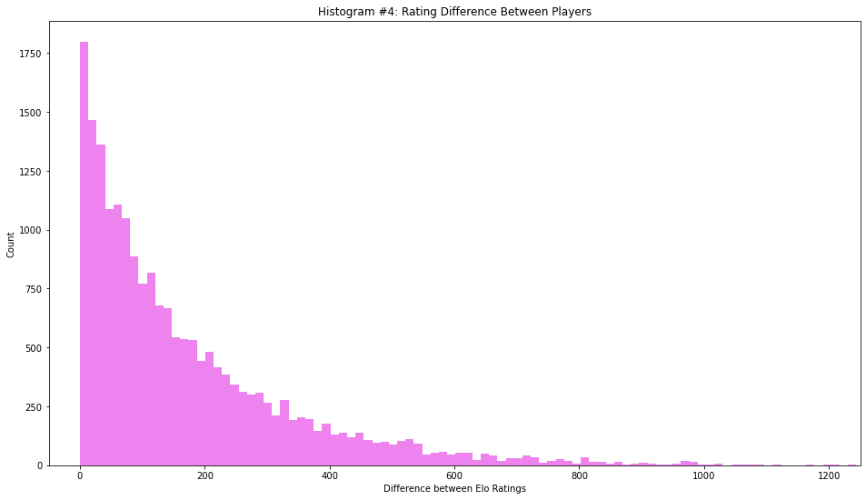
Histogram #4: Rating Differences Between Players
Lichess does a good job at matching players with similar Elo scores. 50% of games occur with players having Elo ratings within 115 points of each other, which isn’t that wide of a margin considering there needs to be a balance between player ratings and how quickly players can enter a game.

Slide 10
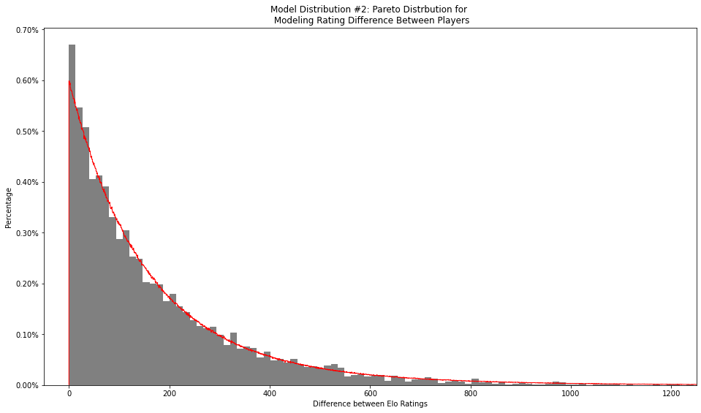

Model Distribution #2: Pareto Distribution for Modeling Differences Between Players
Since most of our match ups occur within a few points of each other, a pareto model is a good fit to represent this data. We have very few outliers where inexperienced players are matched up with world-class players, which is pretty unfortunate for them.

Slide 11
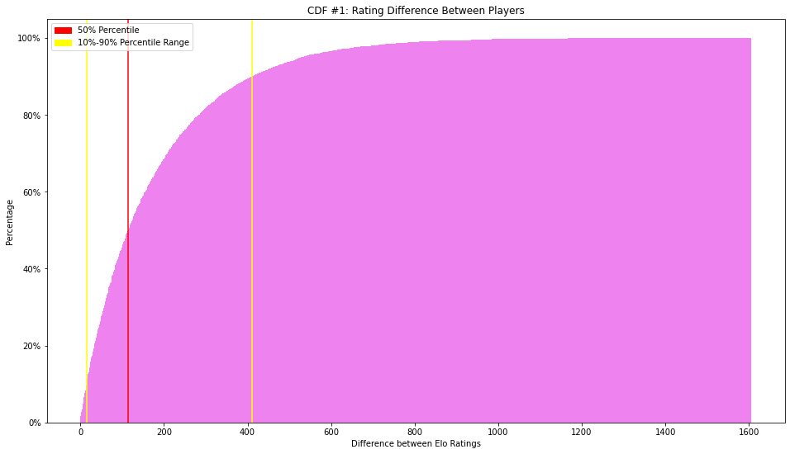

CDF #1: Rating Differences Between Players
We can see that half of our matchups occur within 115 points of each other. There is a difficult balance of matching players of equal skill with each other and getting players into a match quickly, but Lichess does find a good balance between those two factors.

Slide 12
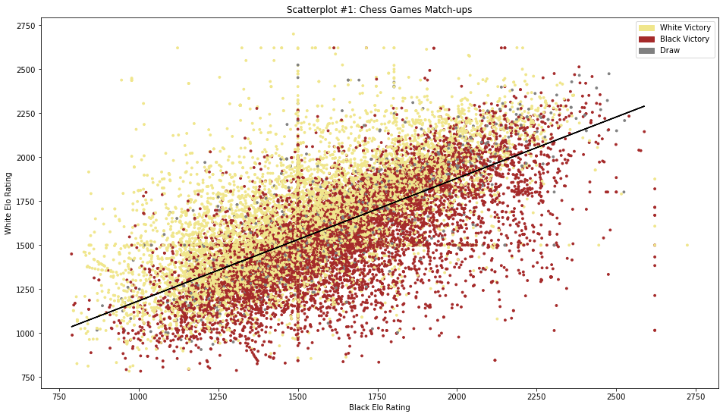

Scatterplot #1: Player vs Player Ratings
Comparing each players score against their opponent, we can see that players with a Elo score larger than their opponent often are victorious. We can also see most draws happen around the same Elo score.

Slide 13
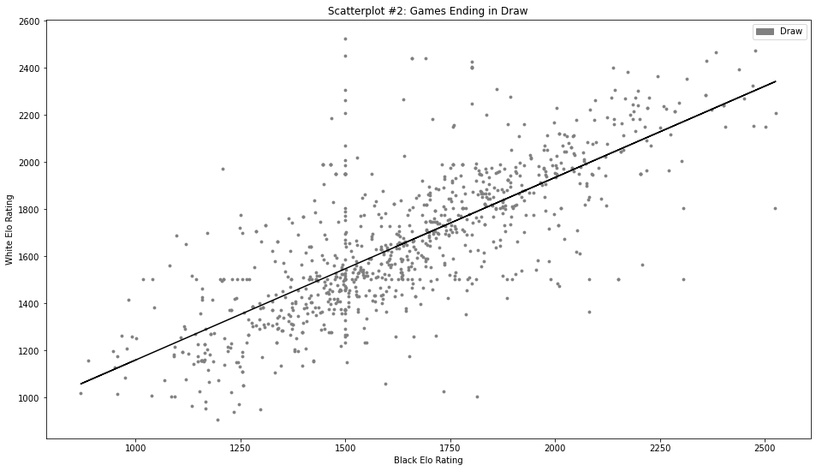

Scatterplot #2: Games Ending in Draw
Similar to our first scatter plot, plotting players ratings against each other when comparing draw games shows us that most draw games occur when player ratings are close. We have a tighter Pearson correlation coefficient in this dataset, indicating a significant trend.

Slide 14
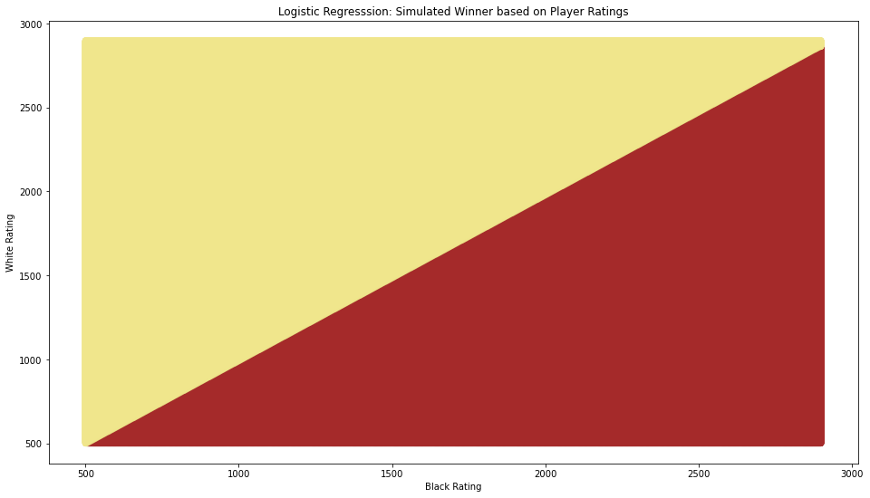
Logistic Regression: Winner based on simulated scores
We can use logistic regression to estimate the winner of each game based on Elo scores. We can see that we have a straight line between both White and Black, but with White encroaching slightly over the y=x line. This might hint at a slight advantage for White.

Slide 15
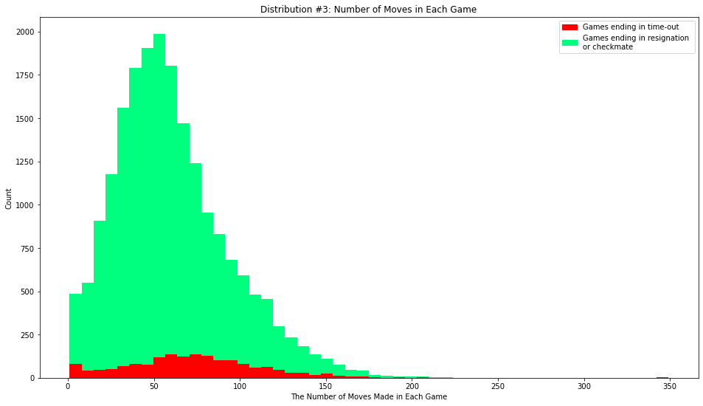

Histogram #3: Number of Moves in Each Game
A typical game of chess lasts for around 50 moves. We have a nice distribution around with a few outliers. The longest game we had in our dataset was 349 moves which ended in time-out.

Slide 16
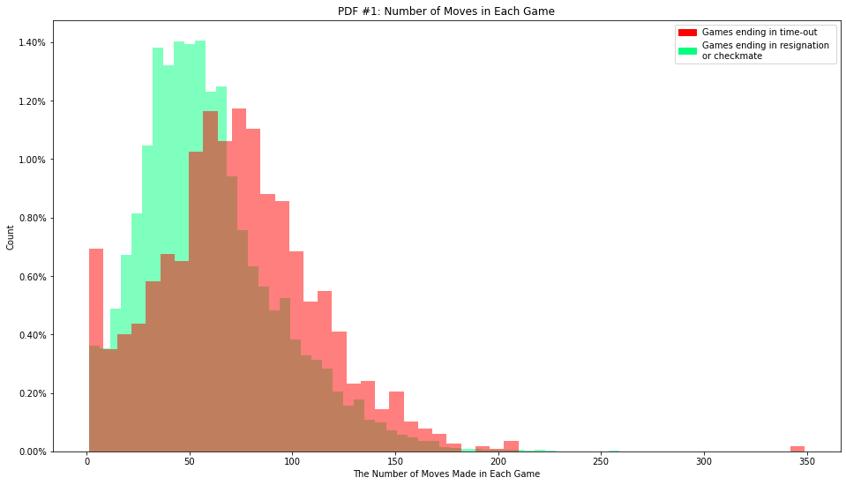
PDF #1: Number of Moves in Each Game
Using a PDF, we can easily see the difference in distribution between games ending in checkmate or resignation and games ending in timeouts.
We have a lot of outliers for our timeout subset at 0 and 1. This is likely due to players abandoning the game without resigning, letting the clock run out.

Slide 17
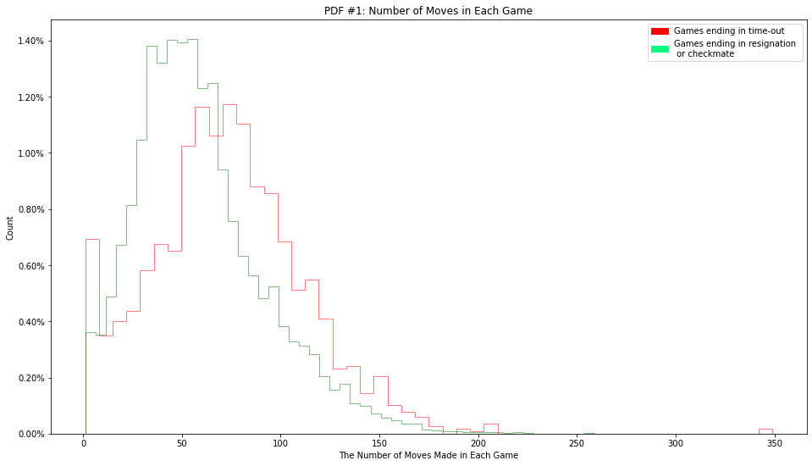
PDF #1: Number of Moves in Each Game
Using a PDF, we can easily see the difference in distribution between games ending in checkmate or resignation and games ending in timeouts.
We have a lot of outliers for our timeout subset at 0 and 1. This is likely due to players abandoning the game without resigning, letting the clock run out.

Slide 18
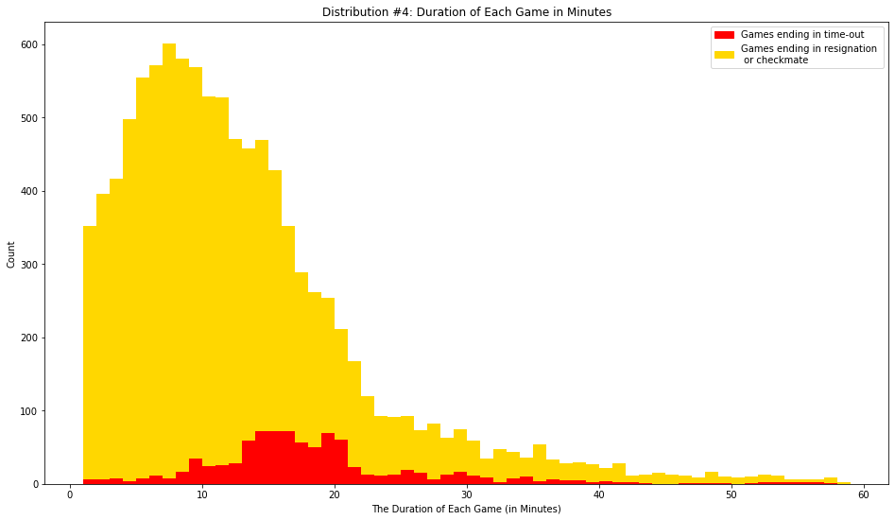

Histogram #4: Duration of Each Game in Minutes
Since we have the start time and end time of each game, we can take those attributes and engineer a new one. Subtracting the starting time from the ending time outputs the number of seconds each game lasted.
We can see that most games last 20 minutes, which makes sense since, in the average game, both players have 10 minutes to use. Some games have longer time limits, so we still see some games lasting longer than 20 minutes.

Slide 19
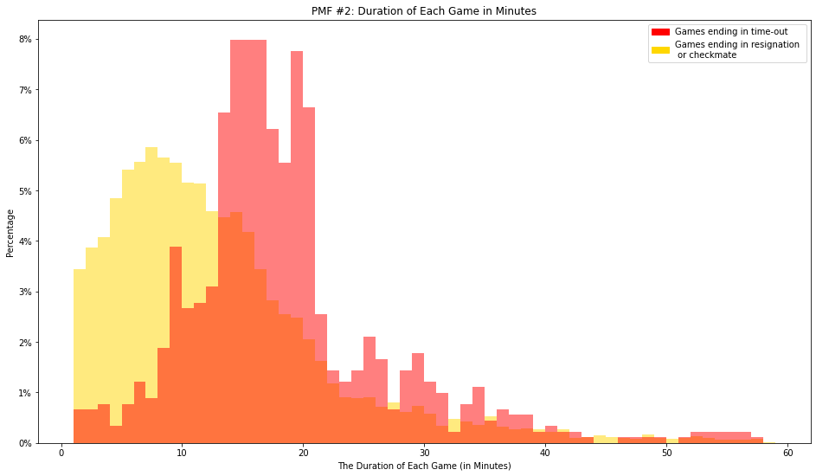
PDF #2: Duration of Each Game in Minutes
Using a PDF, we can see that there is a large drop off at 20 minutes. This makes sense since most games start with both players having 10 minutes to use. If the game ends by timeout, either of the players fully consume their 10 minutes. We have several games lasting longer than 20 minutes though, indicating the game settings are slightly different

Slide 20
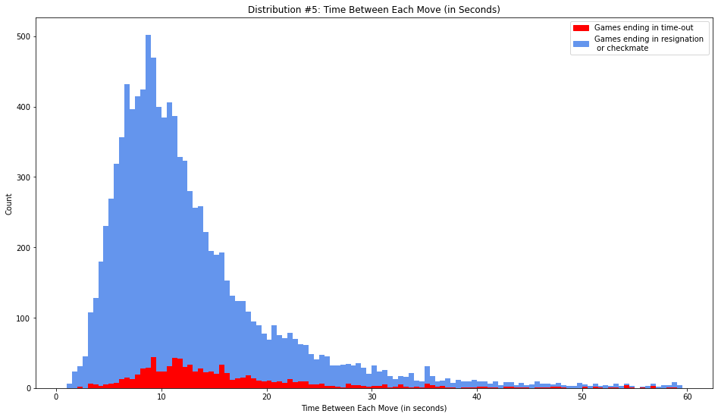

Histogram #5: Time Between Moves in Each Game
Using the engineered attribute from the previous exercise, we can then divide the time of each game by the number of moves in each game. This gives us an approximate time the players need to make their moves.

Slide 21
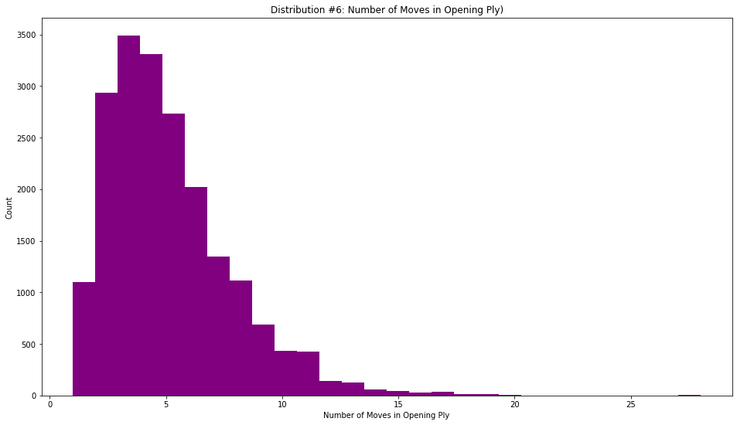

Histogram #6: Number of Moves in the Opening Ply
Many chess games start with by-the-books openings, with names such as Ruy Lopez and The Sicilian Game. These openings have a set number of moves until they deviate into a unique game.
The longest opening in this dataset is the “Ruy Lopez: Marshall Attack | Modern Main Line” containing 28 moves.
This doesn’t tell us too much about the games themselves, but we might be able to see if more experienced players use more advanced plys.

Slide 22
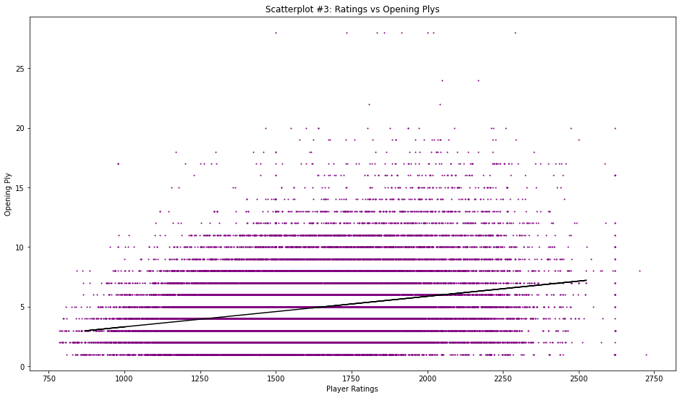

Scatterplot #3: Player Ratings vs Opening Ply
We have a very gradual slope in our scatterplot comparing Player Ratings and Opening Plys.
This would indicate that more experienced players use more “by-the-book” openings while inexperienced players make more unpredictable moves.

Slide 23
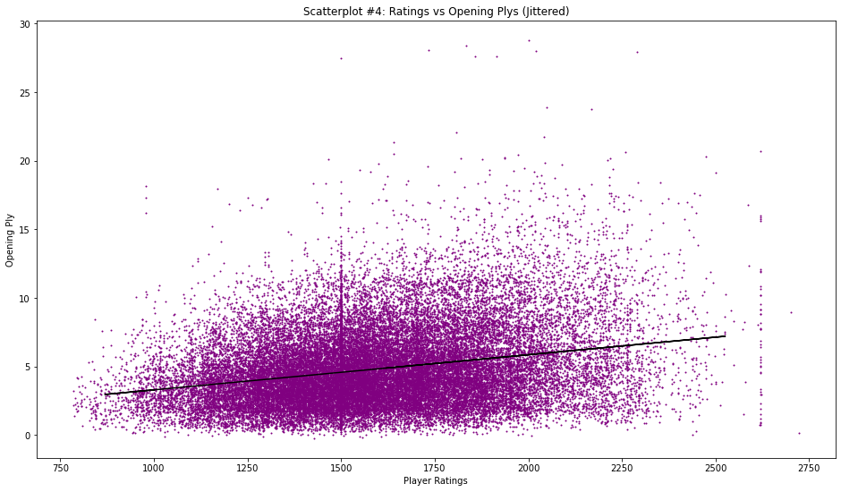
Scatterplot #4: Player Ratings vs Opening Ply (Jittered)
We can add some jitter to our previous chart to make the data more obvious.

Slide 24
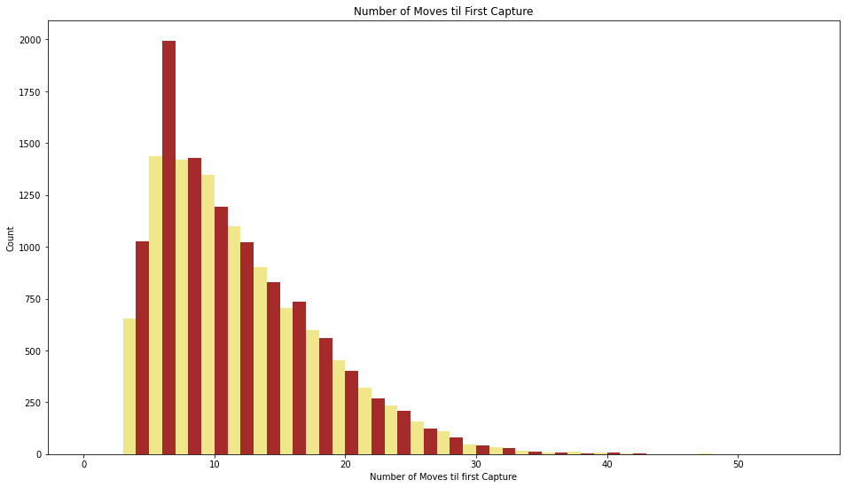

Histogram #7:Number of Moves fil First Capture
By parsing our move data, we can search for “x” in our string to find where the first move was made.
Our first capture only begins at move 3 since moves 1 and 2 are spent developing pieces.
Our mode for this data occurs on black’s turn on the 6th move.

Slide 25
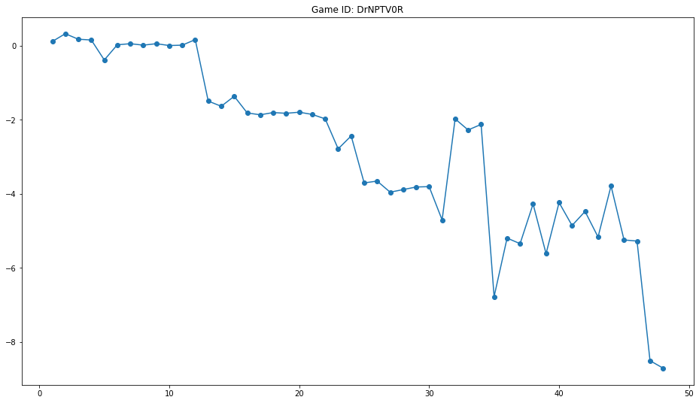
Line Graph: Analyzing Game Scores using Stockfish
We can utilize a chess engine, Stockfish, to analyze our chess games. This takes quite a long time though since each move has to be analyzed against a variety of other moves 20 moves deep.
In this game, black dominates the game having full possession of the board, forcing White to resign.
Our engine outputs a numeric value for each move. If the value is negative, black has the advantage. A positive value would indicate White has the advantage.

Slide 26
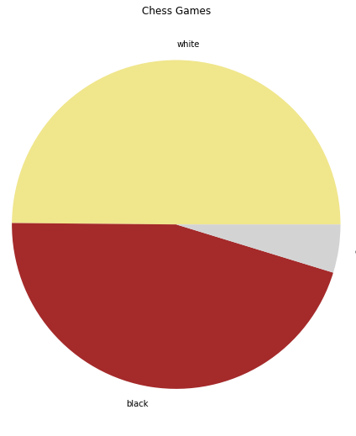
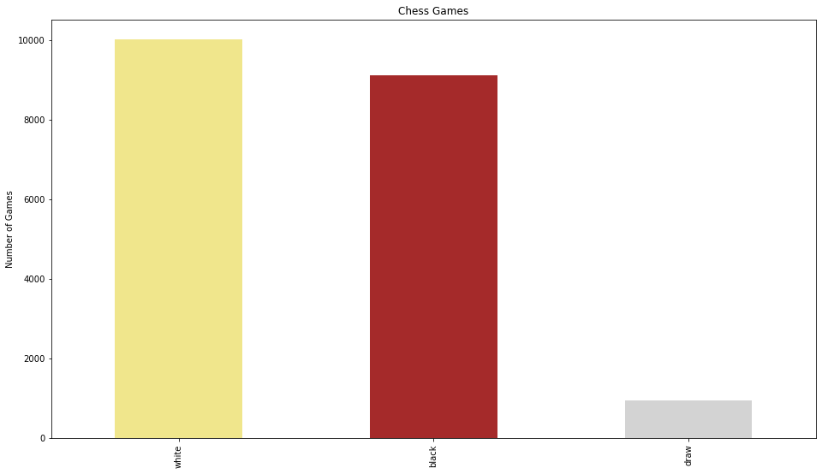
Bar Plot #1: Win Rates
From initial obervations, we can see that white does win more often than black.

Slide 27
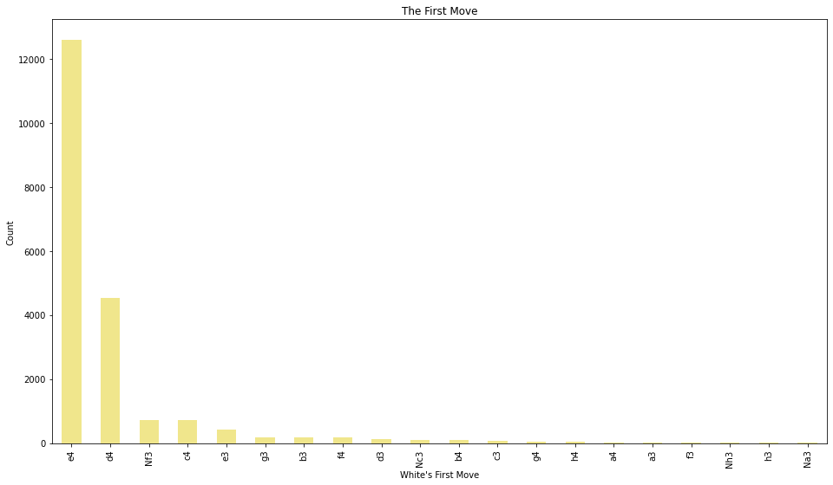
Bar Plot #2: The First Move
When first starting the match, white has 20 possible openings. They can move one of their 8 pawns forward 1 or 2 ranks, totaling 16 moves, or they can move one of their two knights to the two spots on the third rank, adding another 4 possible moves.
Since the primary objective in the start of the game is to control the center of the board, we see e4, “The King’s Pawn Opening” and d4, “The Queens Pawn Opening” dominating the rest of the moves.

Slide 28
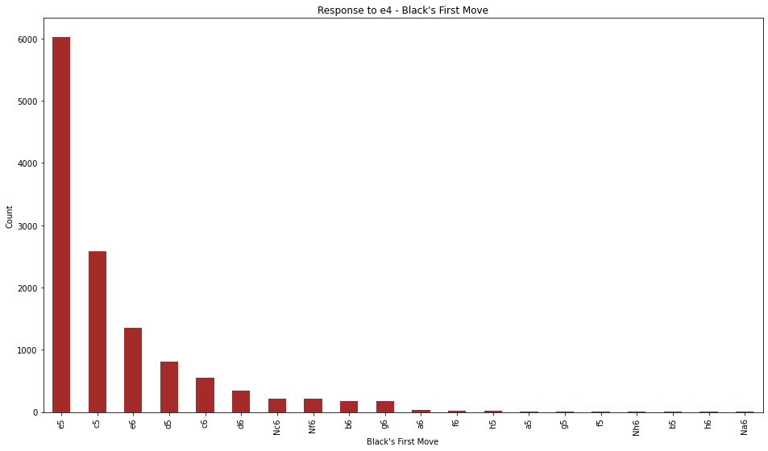
Bar Plot #3: Retaliation: Black’s First Move
Since e4 is the most common opening for White, we can check black’s retaliation. Most common retaliation in this dataset is e5, “The Kings Pawn Game,” followed by c5, “The Sicilian Defense.”

Slide 29
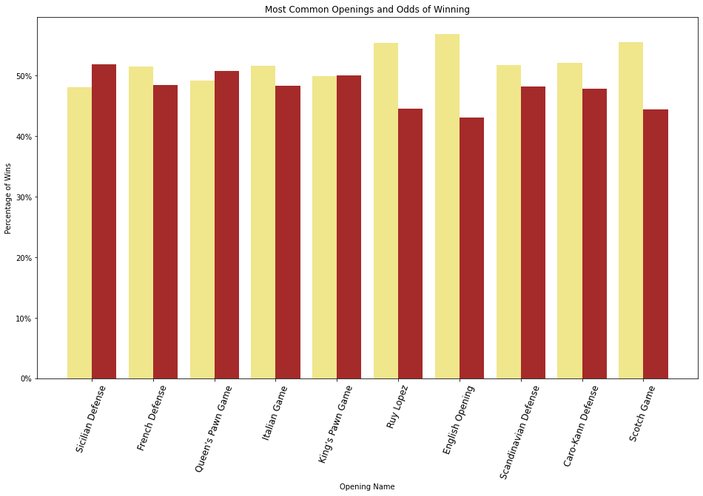
Bar Plot #4: Most Common Openings and Win Rate
White has an advantage with the most common game openings except for the Sicilian Defense and Queens Pawn Game.
According to this data, we can say that, if you are the black player, you have a better chance of winning the game by playing c5 in retaliation to e4.
We can prove this statistically using the Chi-Squared test.

Slide 30
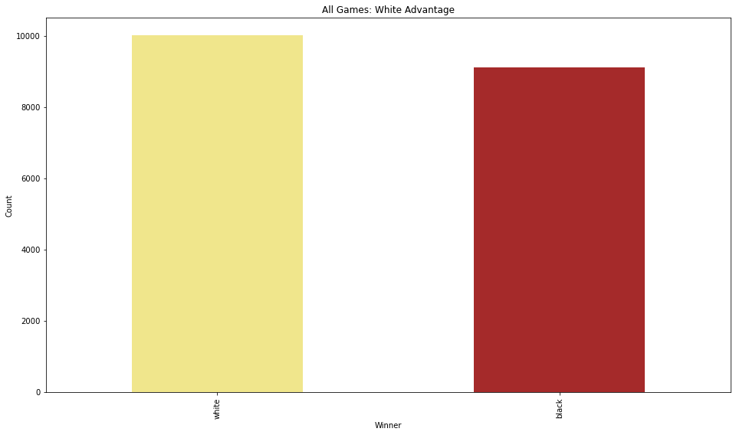
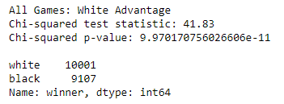
Chi-Squared Test: White has the advantage.
Performing a Chi-Squared test on our dataset, we can see that Whites advantage is very prominent. We have a p-value very close to zero, indicating that this isn’t some sporadic event.

Slide 31
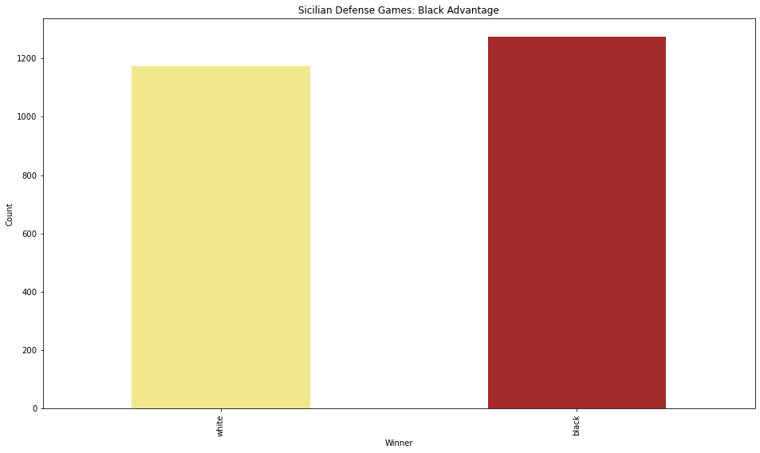
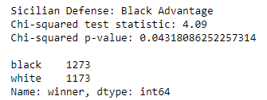
Blacks Comeback: The Sicilian Defense.
There are a few situations that Black can regain a significant advantage during the first few moves of the game. Like we stated before, the odds of black winning a Sicilian Game were larger than Whites. Our Chi-Squared test shows that this trend is significant, so if your opponent plays e4, make sure you play c5

Slide 32

Conclusion
Chess is a complicated game. The tides can turn at the slightest miscalculation between either players, so establishing whether or not a player has an advantage over another is a difficult thing to do, especially when we consider that there are 50+ moves after the opening sequence.
Using the Chi-Squared hypothesis test, we were able to prove that some openings give both players a slight advantage. Whether or not they are able to capitalize on that advantage is up to the skill of the player.
A full breakdown of each openings statistics will be available at the GitHub Jupyter Notebook here.

